Slide 1



Crime Data Analysis for Predictive Policing and Crime Prevention
S Lakshmi Devi

Slide 2
Executive Summary
A brief overview of the project:
Problem Statement: Rising crime rates and inefficient resource allocation challenge law enforcement in identifying hotspots, patterns, and predicting future incidents.
Goal: Use advanced data analysis, time-series modeling, and predictive analytics to support decision-making for crime prevention and resource optimization.
Outcome: Insights into crime patterns, risk-prone areas, seasonal trends, and a predictive ARIMA model for forecasting crime counts by primary type.

Slide 3
Objectives
Perform a detailed exploratory data analysis to uncover trends, patterns, and hotspots.
Engineer features like seasonality, clusters, and repetitive crimes to enhance insights.
Develop a time-series forecasting model to predict crime counts for each primary type.
Create interactive dashboards and paginated reports for actionable stakeholder insights.

Slide 4
Approach and Methodology
Data Preprocessing and Feature Engineering
Exploratory Data Analysis (EDA)
Time Series Modeling
Advanced Analysis
Reporting and Dashboards

Slide 5
Preprocessing and Feature E Engineering
Preprocessing Steps:
Handled missing and duplicate values.
Outlier Handling for numerical datatype using IQR
Feature Engineering:
Created new columns like crime count, season, risk, crime category, high risk time, time_of crime for analysis
Applied clustering to identify high-crime areas and repetitive crime location.
Feature Extraction:
Selected the required columns for training the arima predictive model.

Slide 6
Exploratory Data Analysis (EDA)
Descriptive Analysis - Statistics:
Analyzed summary statistics (mean, median, mode, standard deviation, etc.) to understand the central tendency and dispersion of the data.
Time-Based Analysis - Patterns:
Explored temporal patterns such as trends, seasonality, and cyclic behaviors, especially in data with timestamps.
Geospatial/Location-Based Analysis - Hotspots:
Studied spatial patterns, identifying crime hotspots or patterns based on location data in your crime data analysis project.
Studying Patterns:
Identified patterns, relationships, or anomalies in the data, such as the distribution of certain variables, correlations, and trends over time.
Bivariate and Multivariate Analysis:
Explored relationships between two or more variables (e.g., correlation analysis, scatter plots, pair plots) to understand how features interact.
Heatmap Generation - Covariance:
Generated heatmaps to analyze the covariance or correlation between features, identifying relationships between different variables.
Studying the Distribution - Population of Data:
Analyzed the distribution of data using visualizations like histograms, box plots, and density plots to understand the spread and detect outliers.

Slide 7
Time Series Modeling - ARIMA
Objective:
Forecast crime count for each primary crime category using ARIMA.
ARIMA Model:
ARIMA = AR + I + MA:
AR (Autoregressive): Uses past values.
I (Integrated): Makes data stationary by differencing.
MA (Moving Average): Uses past errors.
Output Inference:
Predicted Crime Counts: Forecast the future crime count for each primary category.
Confidence Intervals: Provide ranges for predictions to quantify uncertainty.

Slide 8
Advanced Visualization & Analysis -
1. Temporal Analysis:
Inference: Crime trends over time can be visualized, identifying peak periods, seasonal patterns, and long-term trends. This helps in understanding when crimes are most likely to occur.
2. Geospatial Analysis:
Inference: A crime density map highlights high-crime areas, aiding in identifying crime hotspots. This can be crucial for resource allocation and policing strategies.
3. Arrest Rate Analysis:
Inference: The arrest rate analysis shows how effective arrests are in relation to crime counts, identifying areas with low arrest rates that may need more attention or improved law enforcement strategies.
4. Crime Count Analysis:
Inference: Crime counts can be analyzed by various primary crime categories to identify which types of crimes are most prevalent, helping in prioritizing efforts to reduce specific types of crime.

Slide 9
Advanced Visualization & Analysis -
5. High-Risk Time Analysis:
Inference: The high-risk time analysis identifies the time periods (e.g., late night or early morning) when crimes are most likely to occur, allowing authorities to focus resources during these critical times.
6. Crime Density Map Based on Location:
Inference: By visualizing crime data on a map, it’s easy to pinpoint hotspot locations where crimes are most concentrated. This can be used for targeted interventions and crime prevention strategies.
7. Seasonal Patterns in Crime:
Inference: Understanding seasonal crime patterns helps in recognizing specific times of the year when crime spikes (e.g., holidays, certain months), assisting in seasonal policing strategies.

Slide 10
Advanced Visualization & Analysis
8. Repeated Crime Based on Crime Count:
Inference: This analysis identifies areas or individuals with repeated offenses, helping law enforcement to focus on repeat offenders and persistent problem areas.
9. Dynamic Query:
Inference: With dynamic queries, users can interactively filter and drill down into crime data, providing customized insights based on different criteria (time, location, crime type, etc.).

Slide 11
Advanced Visualization & Analysis -
10. ARIMA Prediction Model and Chart:
Inference: The ARIMA-generated forecast predicts future crime trends, giving an insight into potential future crime rates. This helps in planning resource allocation, predictive policing, and crime prevention strategies.
11. Paginated Report:
Inference: The paginated report offers a detailed, printable summary of crime data with the ability to generate periodic reports for law enforcement, policymakers, and other stakeholders

Slide 12
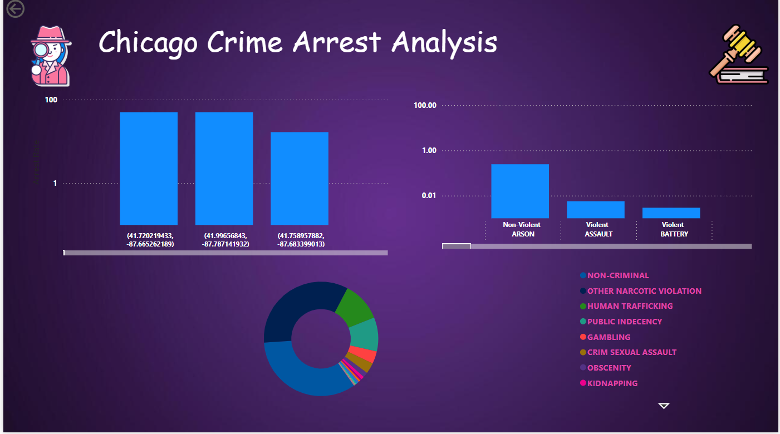
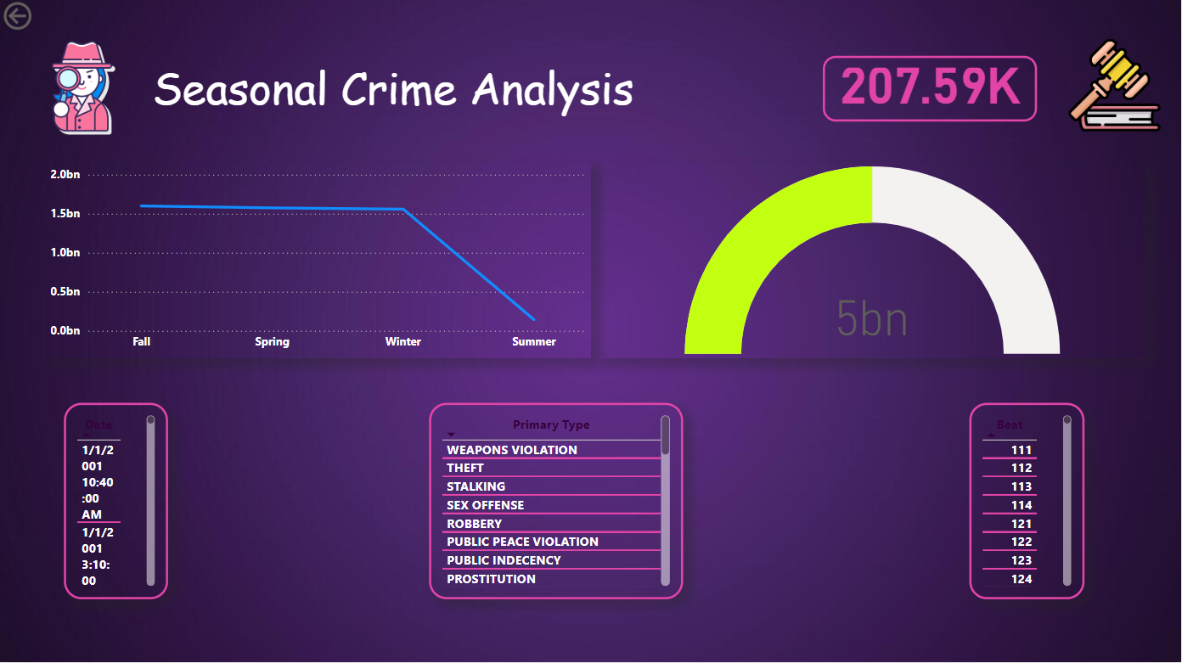
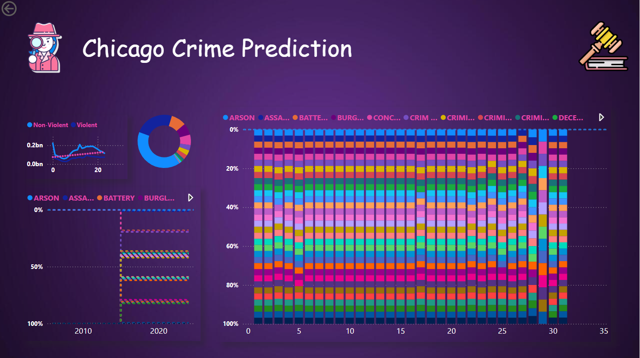
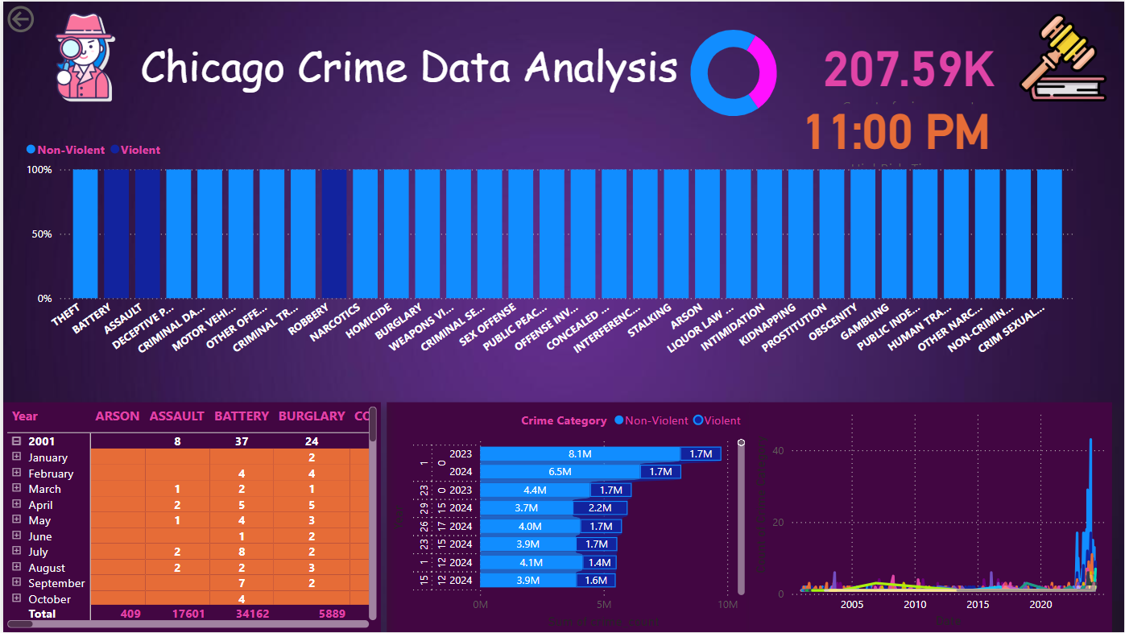
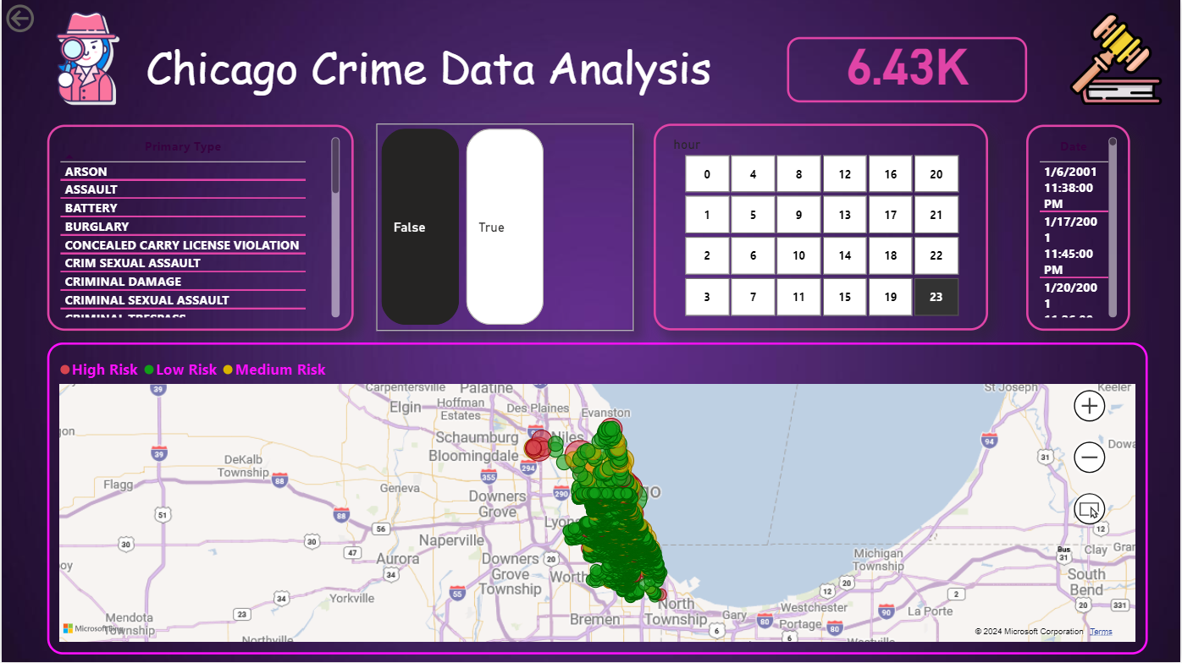
Reporting and Dashboards

Slide 13
Scope and Enhancements
The scope of the "Crime Data Analysis for Predictive Policing and Crime Prevention" project involves analyzing crime data to identify patterns, trends, and hotspots, using techniques like exploratory data analysis (EDA), feature engineering, and predictive modeling.
The project aims to predict future crime trends, detect high-risk areas, and provide actionable insights for law enforcement to improve resource allocation and crime prevention strategies. Key methods include time-series forecasting (ARIMA) and neural networks (RNN, LSTM), along with visualizing the results in interactive dashboards.

Slide 14
Conclusion
The models provide accurate crime predictions, aiding in proactive policing and better resource allocation. Interactive dashboards enhance decision-making, ultimately contributing to improved crime prevention and community safety.

